Slide 1
SCANNING
Week 4
What is Network Scanning?

Slide 2
After reading this chapter and completing the exercises, you will be able to:
Describe port scanning and types of port scans
• Describe port-scanning tools
• Explain what ping sweeps are used for
• Explain how shell scripting is used to automate security tasks

Slide 3
Port-scanning tools can be complex, so you need to devote time to learning their strengths and weaknesses and understanding how and when you should use these tools.
In this chapter, you look at port-scanning tools that enable you to identify services running on a network and use this knowledge to conduct a security test.
In addition, you see how to use shell scripting to automate ping sweeps and other security-testing tasks.

Slide 4
A more important question a security tester should ask is "What services are running on the computers that were identified?"
Port scanning is a method of finding out which services a host computer offers. For example, if a server is hosting a Web site, is it likely that the server has port 80 open?
Are any of the services vulnerable to attacks or exploits?
Are any services not being filtered by a firewall, thus making it possible to load a Trojan program that can send information from the attacked computer?
Which computer is most vulnerable to an attack? You already know how to search for known vulnerabilities by using the Common Vulnerabilities and Exposures (www.cve.mitre.org) and US-CERT (www.us-cert.gov) Web sites.
There are also port-scanning tools that identify vulnerabilities-for example,
Angry IP Scanner (angryip.org), a free port scanner with a GUI interface (see Figure 5-1). Using this tool, an attacker can quickly identify an open port and then launch an exploit to attack the system.

Slide 5
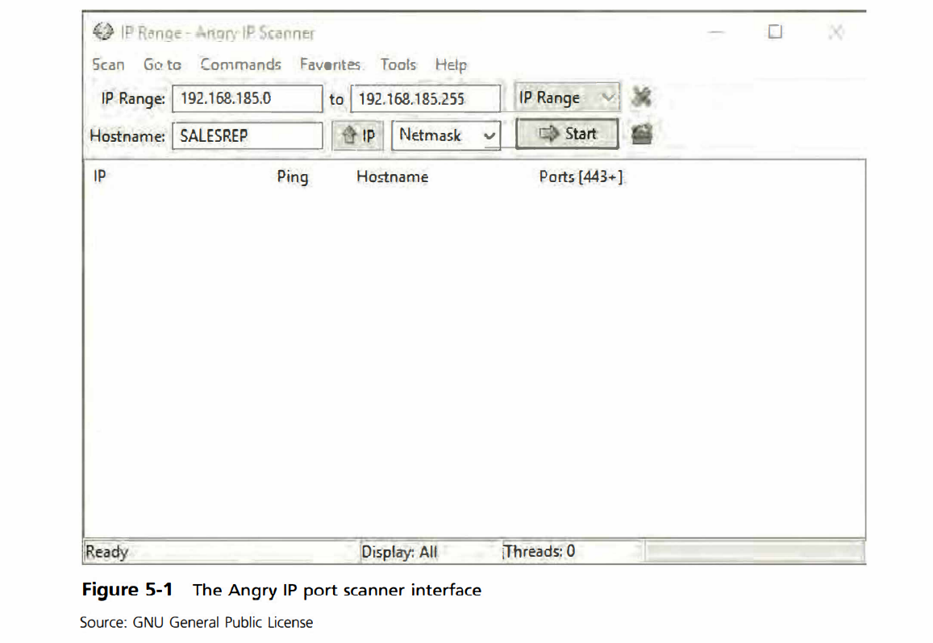

Slide 6
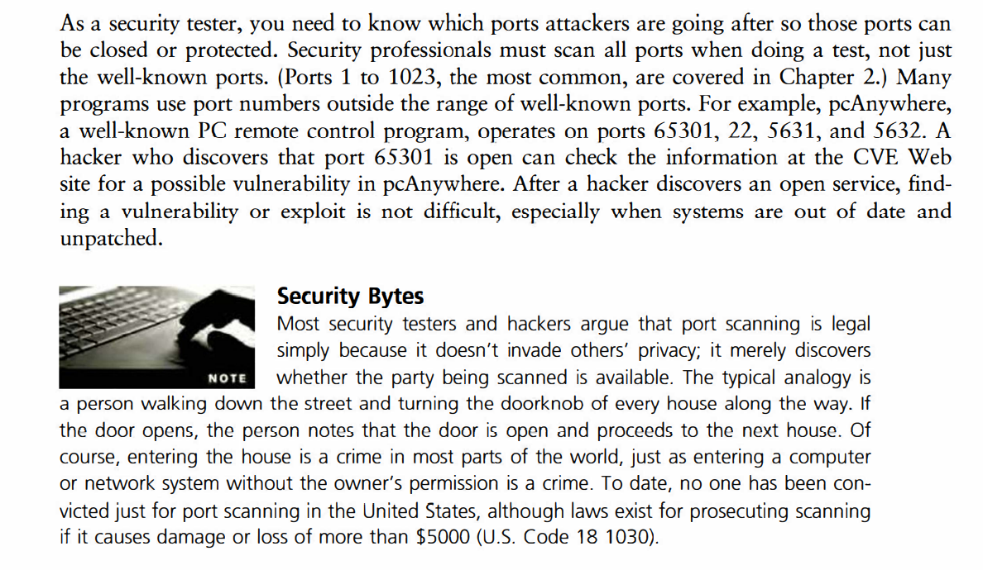

Slide 7
Network is the backbone of any information technology infrastructure, over which data and resources are shared.
In today’s world, when the network is being used for almost everything, “Network Security” is of critical importance. If the network is not secure, any other control is not worth applying.

Slide 8
Types of scanning in ethical hacking
Scanning is the second step in ethical hacking. It helps the attacker get detailed information about the target.
Scanning could be basically of three types:
Port Scanning
Detecting open ports and running services on the target host
Network Scanning
Discovering IP addresses, operating systems, topology, etc.
Vulnerability Scanning
Scanning to gather information about known vulnerabilities in a target

Slide 9
Port scanning could be further divided into 5 types:
Ping Scan
This is the simplest scan. Ping scan sends ICMP packets and wait for the response from the target. If there is a response, the target is considered to be active and listening.
TCP Half Open
Also, referred to as SYN scan, this is another very common type of scanning method.
TCP Connect – TCP connect is similar to TCP half open, except for the fact that a complete TCP connection is established in TCP connect port scanning.
UDP – UDP is used by very common services like DNS, SNMP, DHCP. So, sending a UDP packet and waiting for a response helps gather information about UDP ports.
Stealth Scanning – As the word says, stealth means a quieter activity. When an attacker wants to be undetected while scanning, a stealth scan is used.

Slide 10
Network scanning is the process or technique by which we scan the network to gain details such as active hosts, open ports including running TCP and UDP services, open vulnerabilities, details about the host like operating system and much more.
For IP (internet protocol) networks, generally “ping” is used for reaching a host and checking its status. Ping is an ICMP (Internet Control Message Protocol) utility and sends packets to the target and receives an ICMP echo reply.

Slide 11
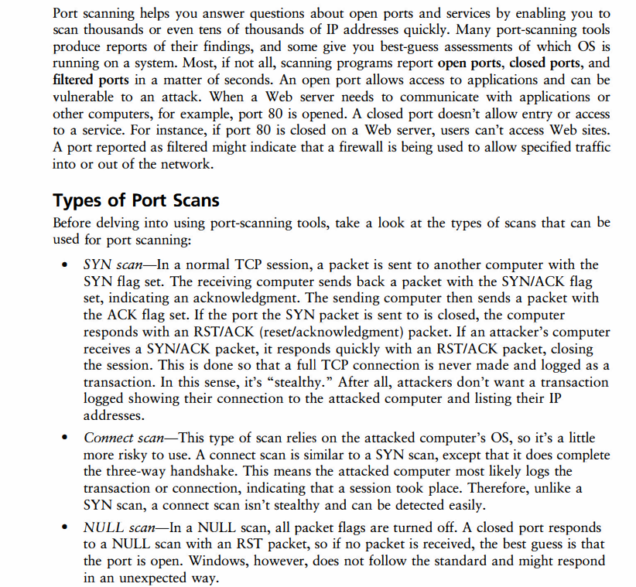

Slide 12
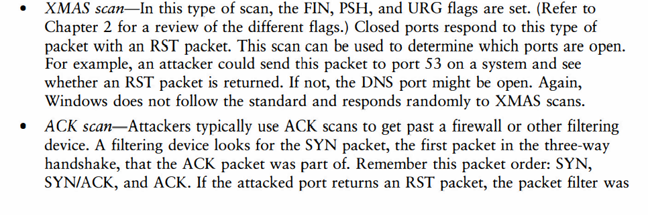
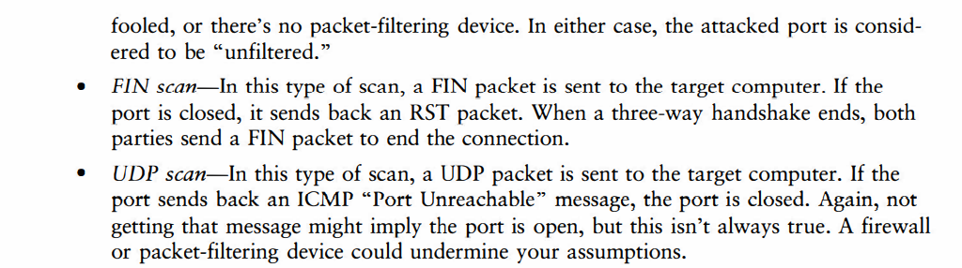

Slide 13
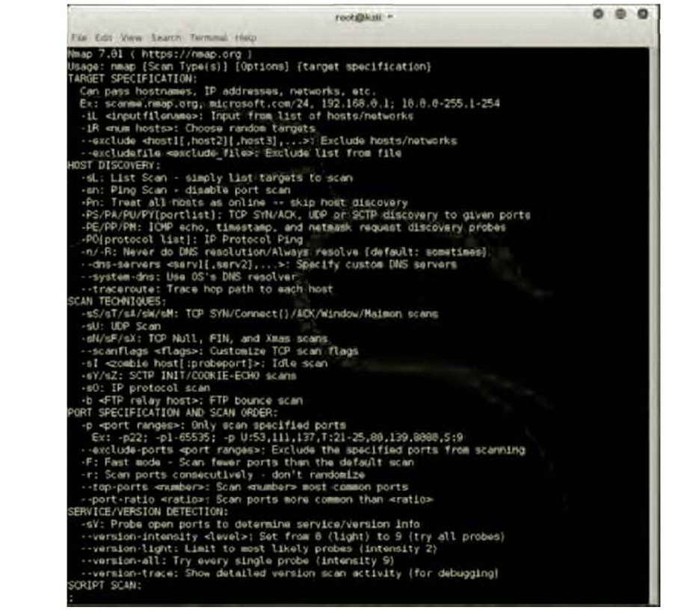

Slide 14
DEMONSTRATION OF SCANNING & CLASS DISCUSSION

